Slide 1
Scraping continued (preprocessing)

Slide 2
Storing Data

Slide 3
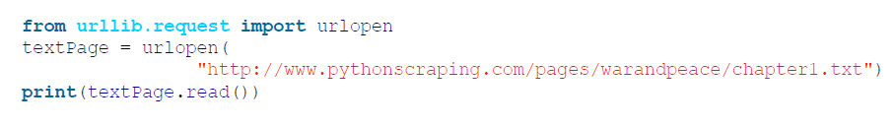
Reading Documents -Text

Slide 4
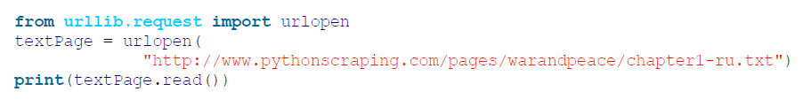
Encodings in action

Slide 5
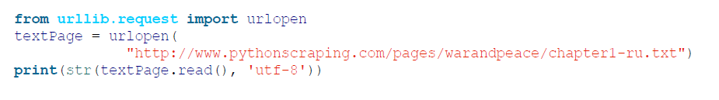

Slide 6
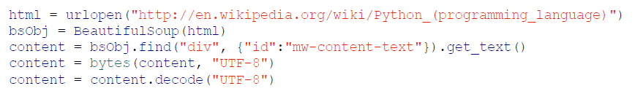

Slide 7


Slide 8
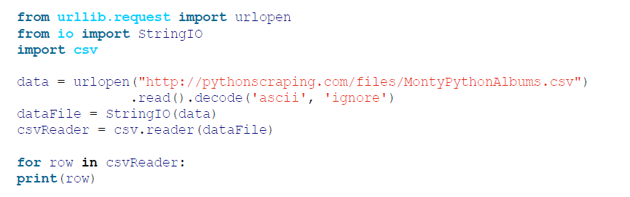
Reading CSV Files

Slide 9
PDF
Microsoft Word and .docx

Slide 10
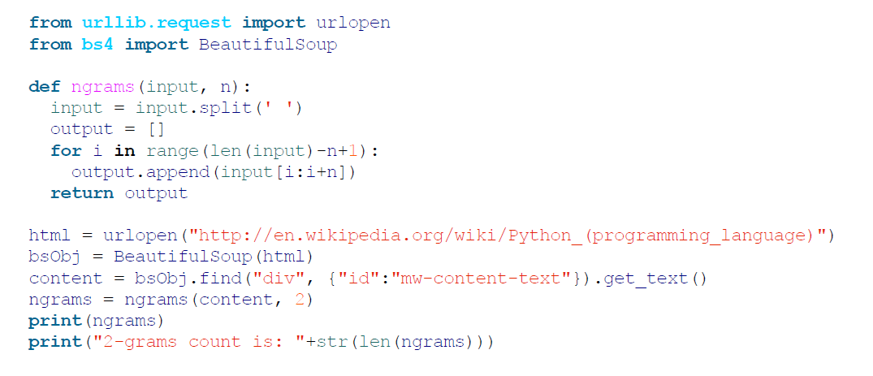
Advanced Scraping
Cleaning Your Dirty Data

Slide 11
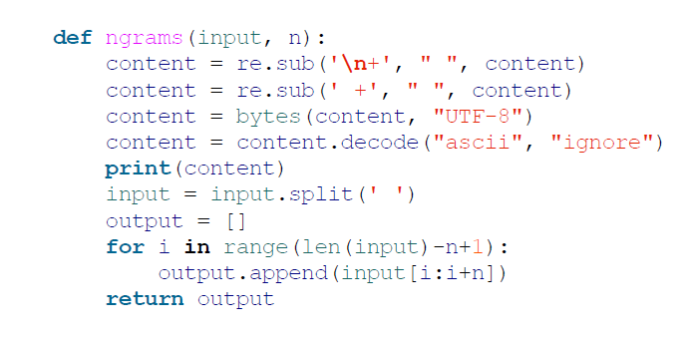

Slide 12
